Slide 1
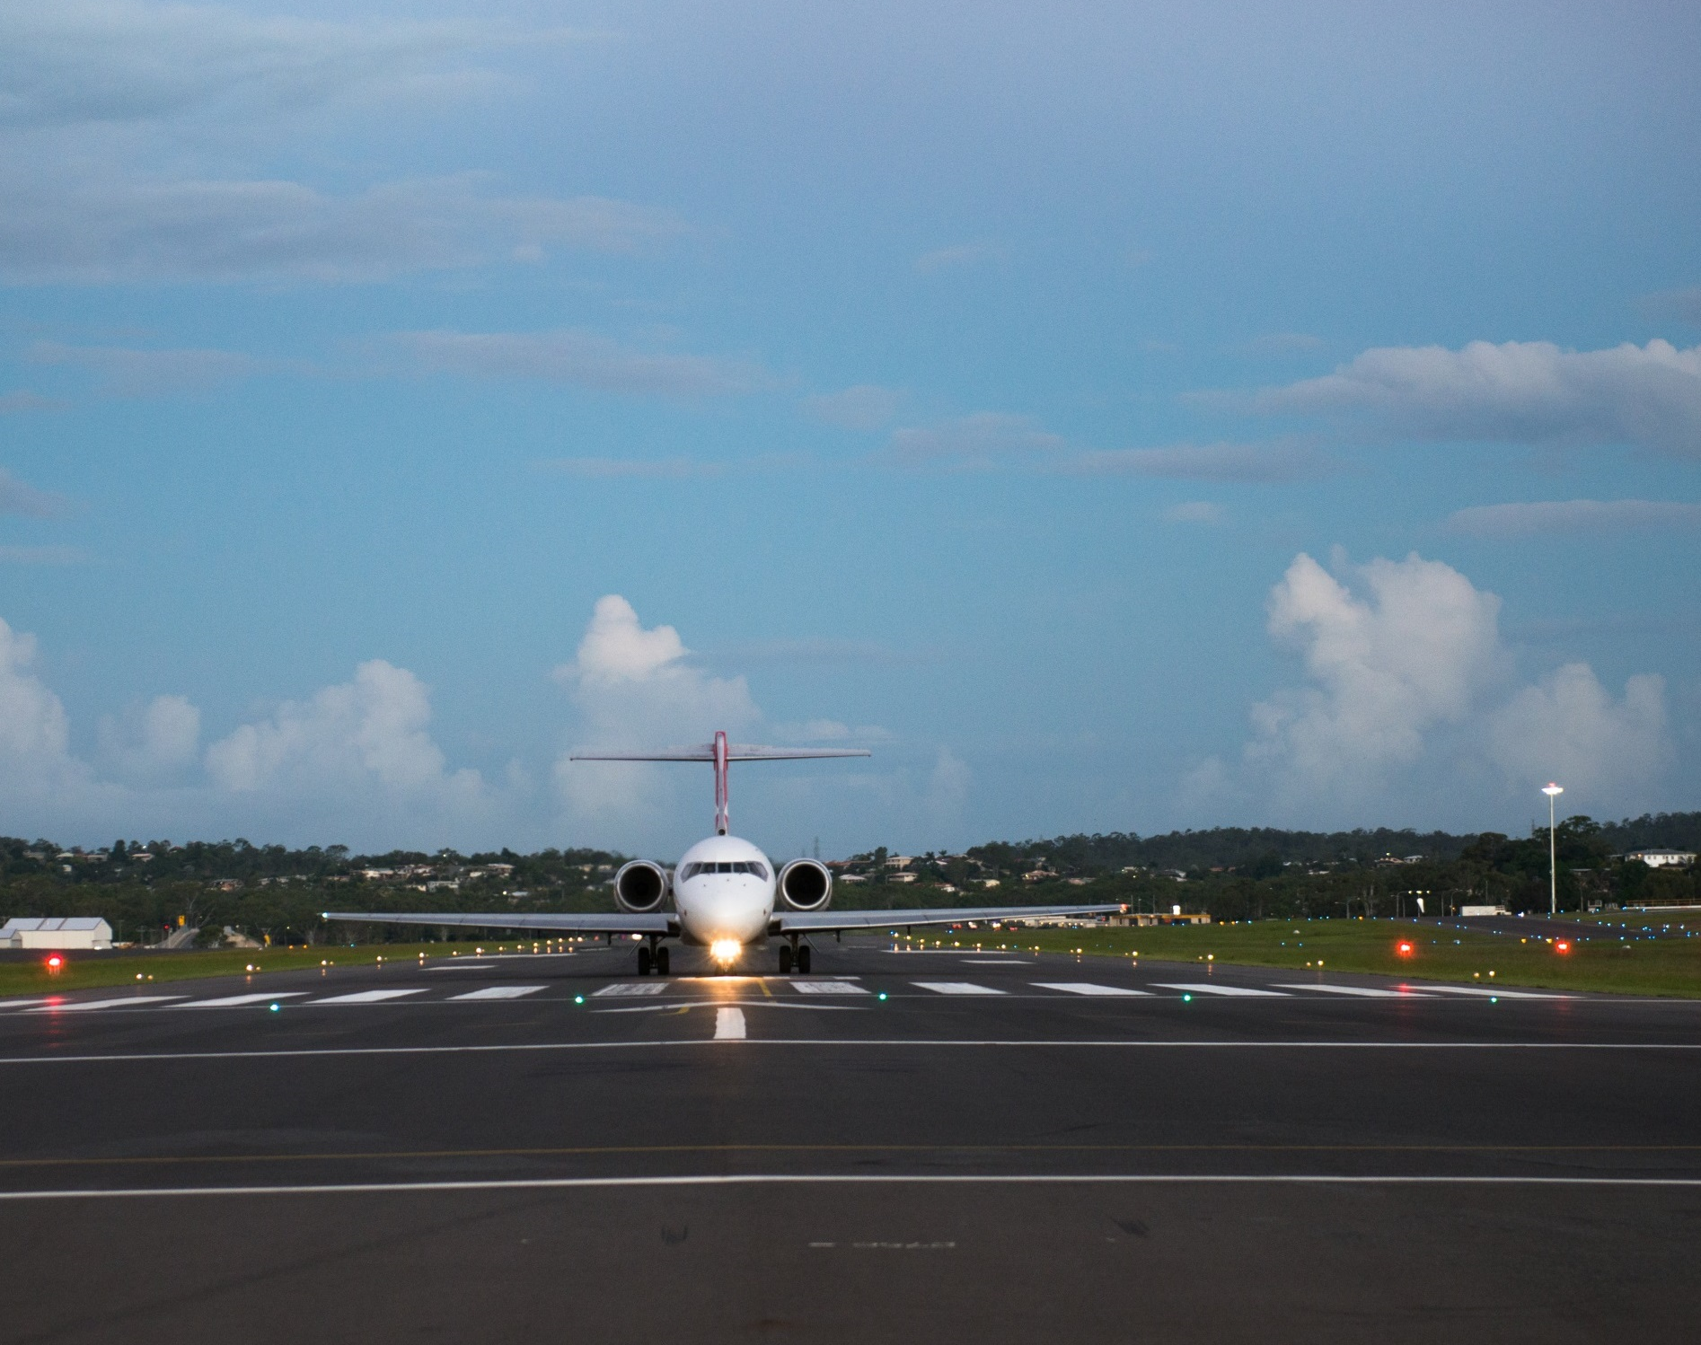
HERVEY BAY AIRPORT
INDUCTION
INFORMATION SESSION

Slide 2

PURPOSE
The purpose of this information session is to outline the requirements & increase the awareness of Hervey Bay Airport operations.
Topics covered during the information session include:
Airport Layout
PPE
Working on Airport height limitation
Access Control
Aviation Security Identification Card (ASIC)
Visitor Identification Card (VIC)
Unattended Suspect articles and vehicles
Evacuation Procedures
Safety Management
Jet Blast and Prop Wash
Foreign Object Debris – FOD
Drug and Alcohol management Plan (DAMP)
Smoking Airside
Dial Before you dig
Hot Work
No Smoking Policy
Prohibitions
Airport emergencies
Significant Security & safety issues
Incident reporting

Slide 3
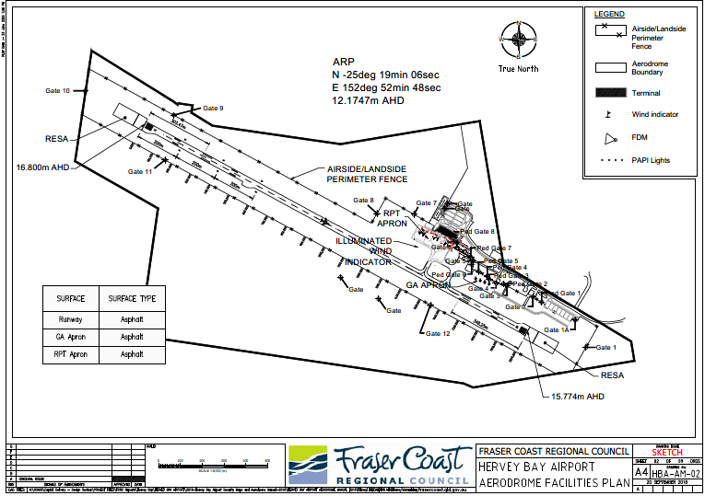
SECURE AREA
The Secure Area of the Hervey Bay Airport

Slide 4

PPE
Safe and appropriate clothing and other personal protective Equipment (PPE) must be worn and used properly while performing work tasks and activities.
High visibility vest and or clothing is mandatory while working in public access areas (e.g. along roads) and while airside
Noise protection should be worn, particularly when near operating aircraft or machinery
Hervey Bay Airport is committed to providing a safe work environment for all employees and contractors; therefore, PPE is mandatory while working on Airport we advise that:

Slide 5
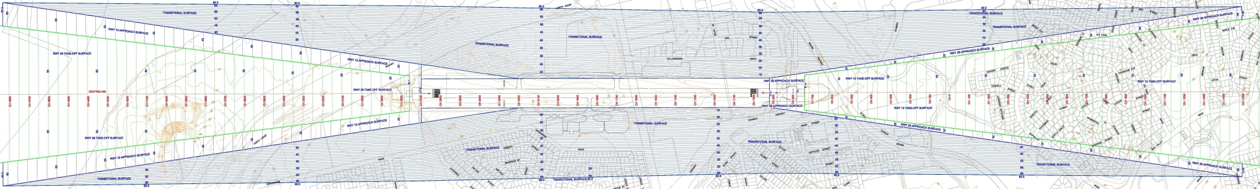
WORKING ON AIRPORT HEIGHT LIMITATION
As the Hervey Bay Airport operator FCRC has a obligation under the Aviation Transport Security Act and Regulations to monitor and maintain the airspace around Hervey Bay Airport. In particular this means identifying and managing obstacles that protrude through the obstacle limitation surface (OLS).
Obstacles which infringe the airport’s Obstacle Limitation Surface (OLS) are a hazard to aircraft. To protect aircraft, there are limitations on the heights of objects permitted around an airport, such as buildings, cranes, work platforms. Limitations vary depending on the location on airport. All crane operations require HBA approval before use.

Slide 6
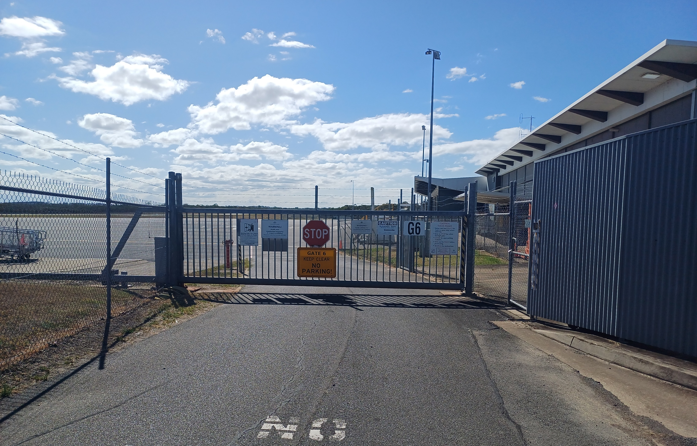
ACCESS CONTROL
Entry to security restricted areas:
Hervey Bay Airport has a number of security measures in place to stop unlawful entries, by mitigating the control of access Hervey Bay Airport ensures:
Only Hervey Bay Airport staff can allow persons, without keys, cards or codes to access the airside areas
Ensure gates are closed before leaving the gate area
Under no circumstances should an open gate be left unattended

Slide 7
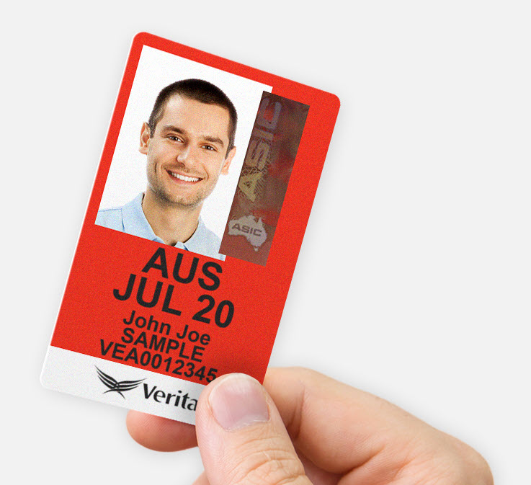
Aviation Security Identification Card (ASIC)
The Aviation Transport Security Act and Regulations are very specific in relation to ASICs.
The ASIC holder must have an operational need to enter an Airside Security Zone or a Security Restricted Area in order to obtain an ASIC.
The ASIC is issued subject to the Aviation Transport Security Act 2004 & Aviation Transport Security Regulation 2005.
A person in a secure area of an airport must properly display a valid red ASIC.

Slide 8
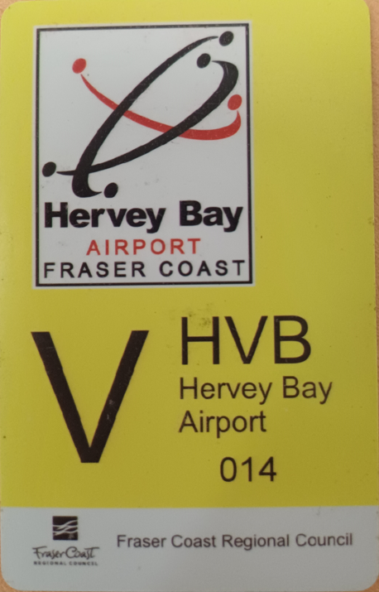
Visitor Identification Card (VIC)
Any person that is required to enter any part of the secure area at Hervey Bay Airport and does not have a valid RED ASIC is required to obtain a VIC pass from a authorised VIC pass issuer. i.e. HVB staff.
A VIC must be displayed above waist height, on the front or side of the body, with the whole front clearly visible. Failure to display will result in being asked to leave the secured area immediately.
A VIC holder must be supervised by a valid RED ASIC holder.
The VIC holder must leave the area immediately if no holder of a RED ASIC is supervising him/her.
Persons found not abiding by the requirements of a VIC holder, must be immediately reported to the AOO’s or Senior Airport Operations Officer.

Slide 9
Unattended Suspect Articles and Vehicles
The airport has adopted the HOT UP principal for staff to make an initial assessment if confronted by doubtful/unattended items.
The HOT UP principal asks staff some simple questions.
Is the item/substance Hidden?
Is the item/substance Obviously suspicious?
Is the item/substance Typical of what is found in the area?
Is the item/substance Unusual?
Has there been general Public access to the area?
If the item raises concern notify your supervisor or the Manager Airport Operations.
The Airport Manager or Delegate will be responsible for the initial assessment of doubtful or unattended items. Local emergency procedures may be instigated if necessary.

Slide 10
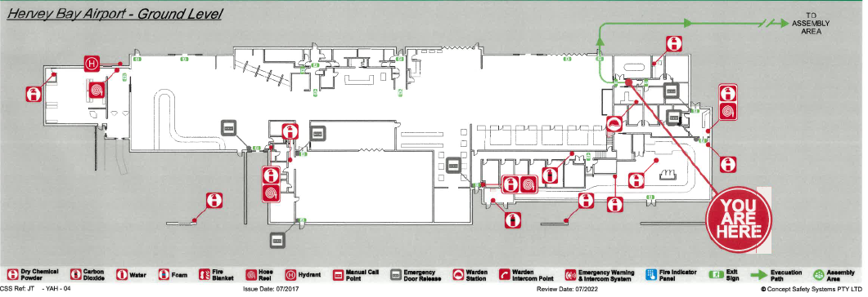
Evacuation Procedure
The fire alarm for the Terminal building will activate automatically at the Queensland Fire & Rescue Service
Wardens are responsible for manning the Fire Indicator Panel and ensuring that all areas of the Terminal building are cleared of people. The warden attending the Fire Indicator Panel must wait for the arrival of the Queensland Fire and Rescue Service.
Evacuation Point for the Terminal Building is located at the Qantas Freight drop off zone. Evacuation Point for the sterile area (airside) is located at Bay 3
Wardens are:
The Airport Operations Officer on duty at the time of the fire alarm.
Deputy Wardens: N/A

Slide 11
Safety Management
All levels of management of Hervey Bay Airport are committed to be involved in the Safety Management System (SMS) for Hervey Bay Aerodrome.
Hervey Bay Airport’s Safety Management System requires:
Hazards to be identified and reported
Incidents and accidents to be reported
All contractors/workers on site have a ‘duty of care’ to act in a safe and responsible manner.
Reporting forms are available from the Airport Administration Office, or upon request to the Airport Operations Officer or Works Safety Officer.
Safety/security breaches may result in exclusion from airside areas/zones of offenders.

Slide 12
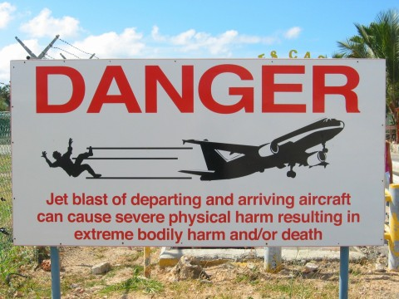
Jet Blast & Prop Wash
The hot compressed air expelled from a jet engine when it’s on the ground can travel up to 170km/h, that’s equivalent to what you’d experience during a Category 4 Cyclone.
BEWARE
Propellers and jet engines create a very strong blast behind the aircraft

Slide 13
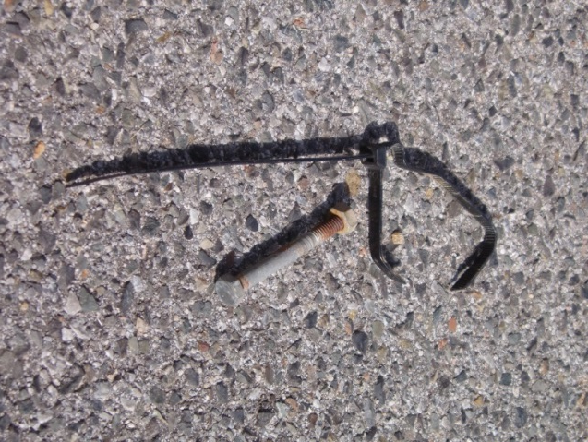
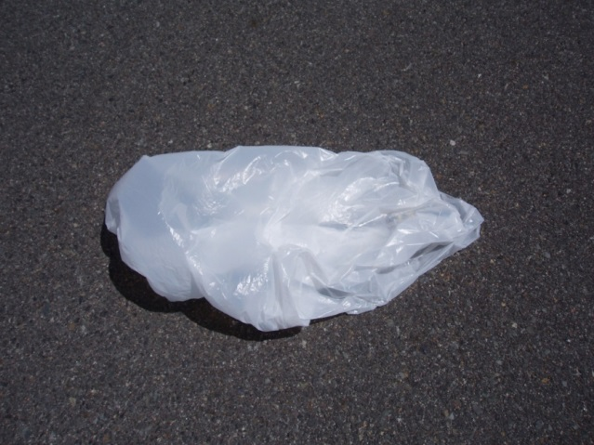
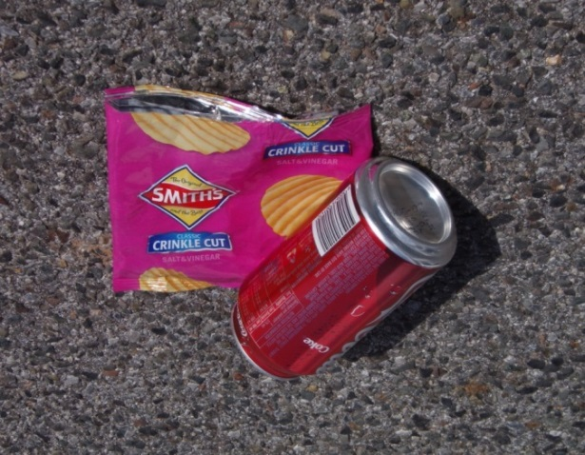
FOD – Foreign Object Debris
Loose items left lying around are called FOD or Foreign Object Debris.
Any loose items, including tools, drink cans or sunglasses can become dangerous missiles if caught in an engine’s jet or prop blast.
Even simple things like a plastic bag, if not securely covered, may be sucked into a jet or prop engine and cause costly damage.

Slide 14
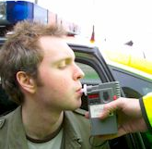
Drug and Alcohol Management Plan (DAMP)
Hervey Bay Airport (HBA) takes the responsibility for the safety and wellbeing of persons at the airport very seriously. Alcohol and other drugs, when present in persons in the workplace, have the potential to increase risk of harm and adversely impact upon fitness for work.
HBA strictly adheres to MOS 139 guidelines, maintaining a zero-tolerance policy for alcohol consumption among all contractors/workers on airport grounds. Consequently, individuals are required to achieve a 0.00 reading on an approved breath testing device, as mandated by MOS 139 regulations.
The DAMP covers FCRC staff and contractors working on HBA property and will include testing in circumstances such as: * Suspicion * After an Accident *Random
Testing will be either saliva/urine for testable drugs and breath testing device for alcohol.

Slide 15

Smoking Airside
There is a no smoking policy in place for the following areas:
All airside areas;
Inside the terminal building and within 4 metres of all entrances to the terminal building; and
Inside any council buildings or vehicles.

Slide 16
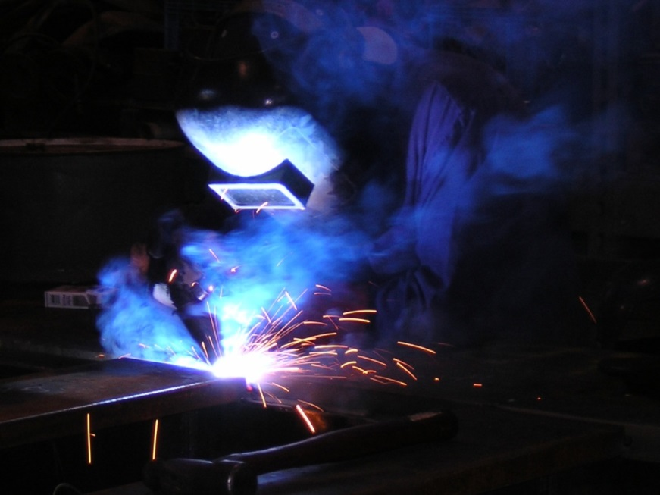
Hot Work
Airport management will require the issue of a Hot Work Permit before any hot work like welding, cutting with power tools and using naked flames can be conducted.
Hot work is not permitted airside when an aircraft is on the apron.
NO welding
NO grinding
NO oxy cutting
NO naked flame

Slide 17
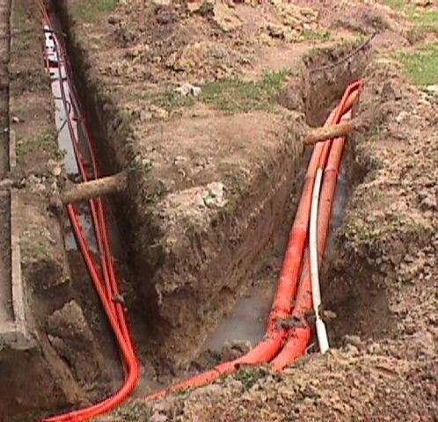
Dial Before You Dig
Hervey Bay Airport has extensive underground electrical and communications cable in the airside work areas.
A trenching permit must be completed prior to commencement of any excavation to ensure no airport electrical, communications or aircraft navigational equipment is damaged or interrupted.
Contact Duty AOO on 0419 671 405 to locate electrical infrastructure on the airport prior to commencing any excavation.
All contractors are responsible for locating all other underground infrastructure on the landside.

Slide 18

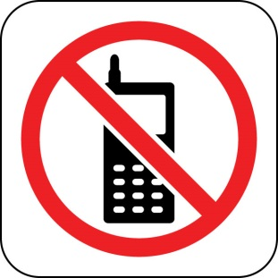

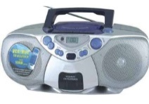
Prohibitions
In the interests of aircraft and personal safety, the
following prohibitions apply airside.
Restrict the use of mobile phones to operational necessity only
No Smoking
No Personal Music Devices and Headphones
No Portable Music Players

Slide 19
Airport Emergencies
In the event of an emergency, you may be required to evacuate the work site and proceed to the evacuation point
There are trained personnel to assist with the evacuation.
An audible warning to evacuate is given by the fire alarm.
In emergency situations announcements are made by the fire wardens.
Evacuation diagrams are located on the walls around the Terminal.

Slide 20
Significant Safety & Security Issues
Airspace
Gates
VICs and ASICs
Hazards, Incidents, Accidents
Prop Wash and Jet Blast
FOD
Digging
Drugs and Alcohol
Smoking, Radios, MP3’s
ARO’S INSTRUCTIONS
Keep Obstacle Free
Close
Display Correctly
Report
Keep Clear
Remove
Ask First
Don’t put yourself and others at risk
Not on the Airside
OBEY IMMEDIATELY

Slide 21
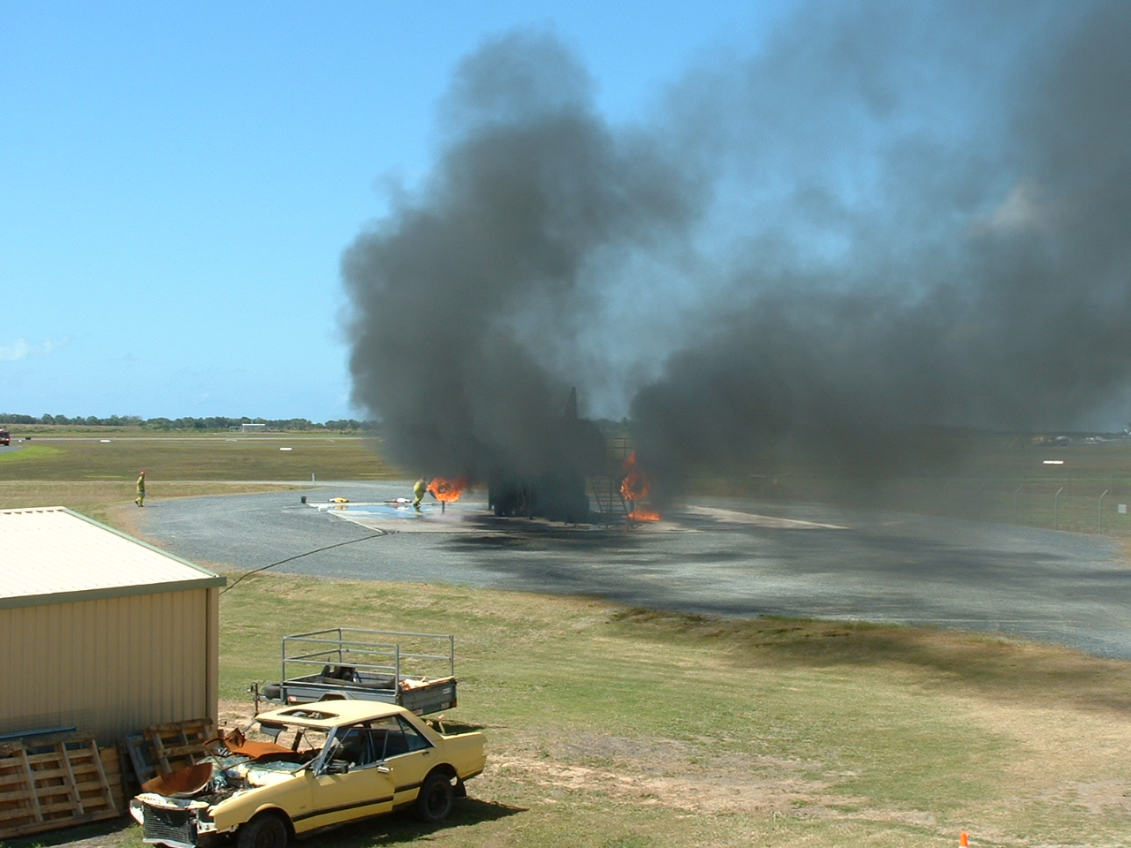
Incident Reporting
All incidents, including:
- accidents
- fuel spills
- and injuries
which occur in any part of the Airport, must be reported immediately to an Airport Operations Officer on 0419 671 405

